Slide 1
Company X Analysis Report
This is a report I created for a client whose name is fictionalized as X for confidentiality
By Zohaib Aftab

Slide 2
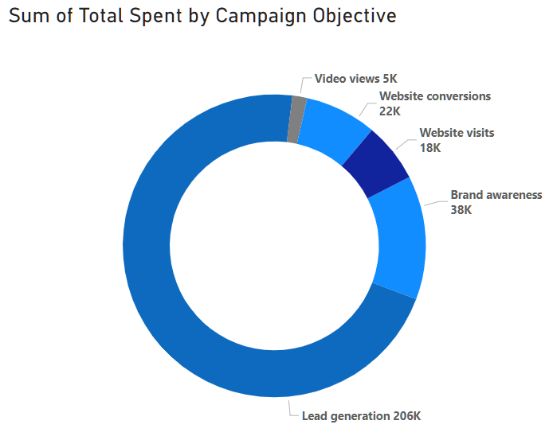
Overview of data
Spend data from Jan-Dec of the year
Total spend: $288,903
Total KPI value: 12,344
Spend spread across 5 Objectives
Lead Generation (71%)
Brand Awareness (13%)
Website Conversions (7.7%)
Website Visits (6.4%)
Video Views (1.6%)

Slide 3
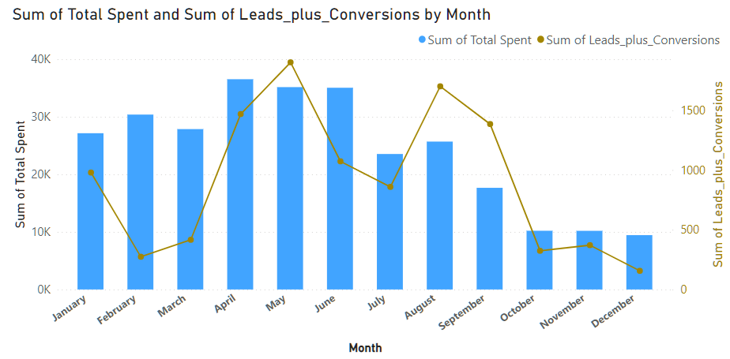
A majority of spending made in the first 6 months
Bars represent the spend
Line represents the sum of leads and conversions

Slide 4
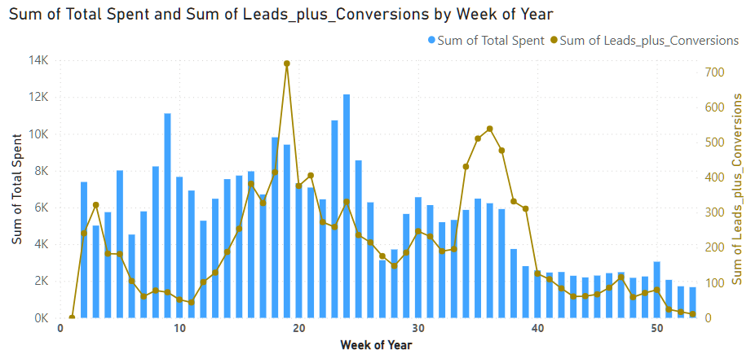
When seen on a Weekly basis
We see 2 peaks in the conversions/ leads
A dip in conversions/ leads in Q1 is observed

Slide 5
Questions to ask
1
2
What explains
What explains
The dip in conversions in Q1 (weeks 6-13) despite high spend?
An uptick in conversions/leads during weeks 18-20 and weeks 34-37?

Slide 6
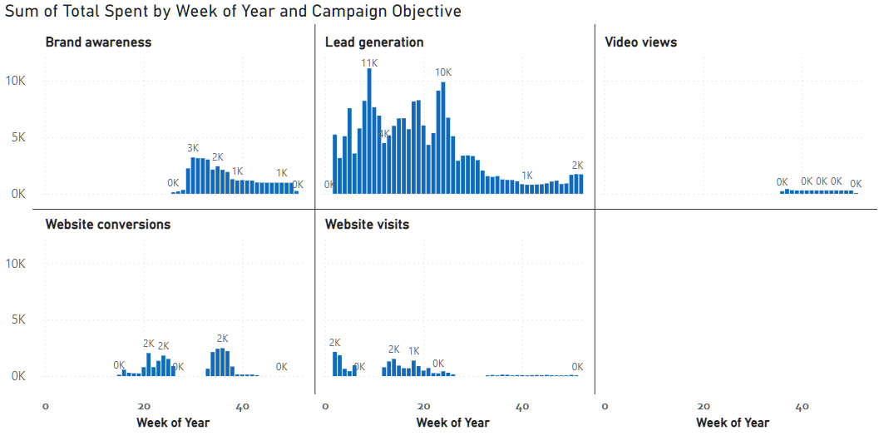
To answer these, we need to get to the campaign level
Spend by Campaign Objective over 52 weeks
Major campaign, active for all 52 weeks
Starts week 26 onward
Very low spend
Starts after week 14 and then week 32

Slide 7
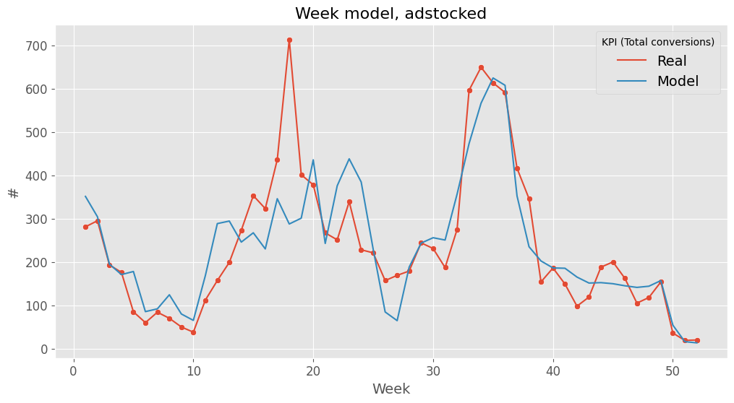
Built a campaign-level regression model
The model captures the 2nd peak well, but fails to account for the first one
Model is only 72% accurate
The initial dip is well captured

Slide 8
Results
Coefficients for each campaign (conversions per $1000)
 | Campaign | Coefficient | Statistical Significance | Remarks
1 | Lead Generation | 10 | Not significant | Largest spend and CPA
2 | Brand Awareness | 58 | Significant | Campaigns indicating potential to drive conversions
3 | Website Conversions | 120 | Significant
4 | Website Visits | 131 | Significant
5 | Video Views | 190 | Not significant | Large Coeff, but negligible spend, so neglect it
6 | Intercept | -14 | Not significant | Can essentially be considered zero

Slide 9
Conclusion of Part 1
The intercept value is negative, but not statistically significant, so essentially Zero
The model identifies 3 campaigns with significant effect on conversions including:
Brand Awareness
Website Conversions
Website Visits
But the spike in conversions from week 18-20 is ignored by this model

Slide 10
Can we measure incremental effect of these 3 campaigns?

Slide 11
Incremental effects
I used a technique called Regression Discontinuity Design to study the causal relationship between a campaign and resulting conversions
Idea is to analyze the periods just before and just after the start of a campaign (min. $500 spend per wk) and compare the KPI data
Provided that the overall spend on other campaigns is similar in both periods
I developed a few more models to analyze these effects

Slide 12
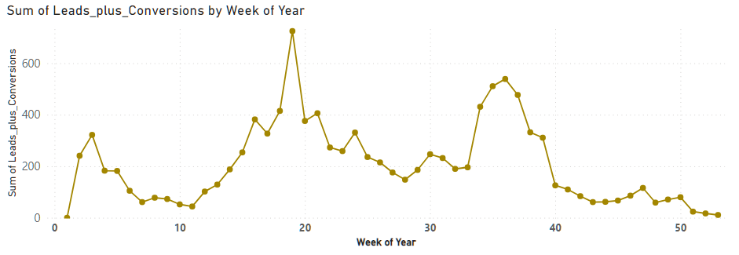
Incremental effect: Website Visits 1
This campaign started at 12th week (vertical line), so we analyze weeks 7 – 18 (boxed zone)
Model shows that the this campaign is responsible for 322 additional conversions per week in this zone.
Campaign OFF
Campaign ON
Notes:
But this effect is not statistically significant so we can’t be sure

Slide 13
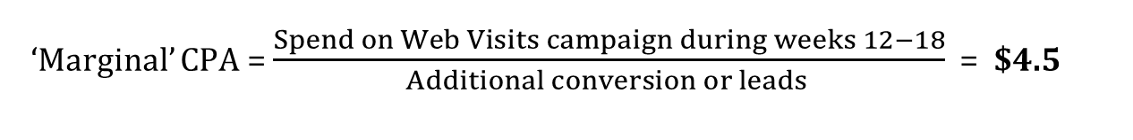
Incremental effect: Website Visits 1
‘Marginal’ CPA = $\frac{Spend on Web Visits campaign during weeks 12−18}{Additional conversion or leads }$ = $4.5
Campaign OFF
Campaign ON

Slide 14
Incremental effect: Website Visits 2
Another zone of interest for this campaign is right at the start
Model shows an increment of 119 additional conversions per week in weeks 1 to 5.
Marginal CPA = $15.7
Campaign ON
Campaign OFF
Notes:
But this effect is not statistically significant so we can’t be sure

Slide 15
Incremental effect: Brand Awareness
This campaign started at 28th week so the shaded zone (week 26-31) is analyzed.
Its marginal effect on the conversions is effectively Zero.
Campaign OFF
Campaign ON

Slide 16
Incremental effect: Website Conversions
Accelerates from 19th week.
But its effect could not be isolated due to considerable overlap with the Website Visits campaign during the same period.

Slide 17
To sum up the results
This sharp increase is credited to the Website Visits campaign.
Regression model missed it.
This climb is the combined effect of Web Conversions and Brand Awareness campaigns.
All other campaign were running low in this period.
This dip is explained by the solo run of Lead Gen campaign.

Slide 18
Conclusion
Website Visits campaign drives more conversions than Website Conversions campaign
an effect not visible via regression (both have similar coefficients), but through incrementality analysis
Brand Awareness and Lead Generation campaigns alone do not drive considerable leads/conversions
Confirmed by both regression model (through small coeff values) and incrementality analysis

